Slide 1
Lecture 10
Topics
Application of DFS
  Topological Sort
  Strongly Connected Components
Reference: Introduction to Algorithm by Cormen
Chapter 23: Elementary Graph Algorithms

Slide 2
Directed Acyclic Graph
A directed acyclic graph or DAG is a directed graph with no directed cycles:

Slide 3
DFS and DAG
Theorem: a directed graph G is acyclic if and only if a DFS of G yields no back edges:
  => if G is acyclic, will be no back edges
    Trivial: a back edge implies a cycle
  <= if no back edges, G is acyclic
    Proof by contradiction: G has a cycle ⇒ ∃ a back edge
      Let v be the vertex on the cycle first discovered, and u be the predecessor of v on the cycle
      When v discovered, whole cycle is white
      Must visit everything reachable from v before returning from DFS-Visit()
      So path from u (gray)→v (gray), thus (u, v) is a back edge
v
u

Slide 4
Topological Sort
Topological sort of a DAG:
  Linear ordering of all vertices in graph G such that vertex u comes before vertex v if edge (u, v) ∈ G
Real-world application:
  Scheduling a dependent graph,
  Find a feasible course plan for university studies

Slide 5
Example
Undershorts
Socks
Watch
Pant
Shoes
Shirt
Belt
Tie
Jacket

Slide 6
Example (Cont.)
Undershorts
Socks
Watch
Pant
Shoes
Shirt
Belt
Tie
Jacket
Socks
Undershorts
Pant
Shoes
watch
Shirt
Belt
Tie
Jacket

Slide 7
Algorithm
Undershorts
11/16
Socks
17/18
Watch
12/15
Pant
Shoes
13/14
9/10
Shirt
1/8
6/7
Belt
Tie
2/5
Jacket
3/4
Socks
Undershorts
Pant
Shoes
watch
Shirt
Belt
Tie
Jacket
17/18
11/16
12/15
13/14
9/10
1/8
6/7
2/5
3/4

Slide 8
Algorithm
Topological-Sort()
{
  Call DFS to compute finish time f[v] for each vertex
  As each vertex is finished, insert it onto the front of a linked list
  Return the linked list of vertices
}
Time: O(V+E)

Slide 9
Strongly Connected Components
Every pair of vertices are reachable from each other
Graph G is strongly connected if, for every u and v in V, there is some path from u to v and some path from v to u.
Strongly Connected
Not Strongly Connected

Slide 10
Example
a
{ a , c , g }
g
c
d
{ f , d , e , b }
e
f
b

Slide 11
Finding Strongly Connected Components
Input: A directed graph G = (V,E)
Output: a partition of V into disjoint sets so that each set defines a strongly connected component of G

Slide 12
Algorithm
Strongly-Connected-Components(G)
call DFS(G) to compute finishing times f[u] for each vertex u. Cost: O(E+V)
compute G^{T} Cost: O(E+V)
call DFS(G^{T}), but in the main loop of DFS, consider the vertices in order of decreasing f[u] Cost: O(E+V)
output the vertices of each tree in the depth-first forest of step 3 as a separate strongly connected component.
The graph G^{T} is the transpose of G, which is visualized by
reversing the arrows on the digraph.
Cost: O(E+V)

Slide 13
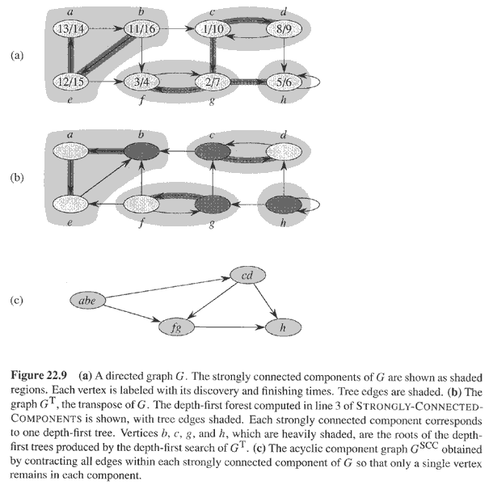
Example

